Slide 1

The Science of Breathwork
Presented By | HealthCheck360

Slide 2

Agenda
What is breathwork?
Benefits
Tips to incorporate it into your life
Notes:
To Change a Picture
Right click on the picture you want to change, click “change picture,” then “from a file.”
O:\Wholesale Sales & Marketing\1. HealthCheck360\8. Templates\PowerPoint\Photos for PowerPoint

Slide 3

What is breathwork?
Breathing techniques that intentionally channel and focus on breath.
“Conscious breathing”
“Deep breathing”
Lateral Raise
https://health.clevelandclinic.org/breathwork
Notes:
To Change a Picture
Right click on the picture you want to change, click “change picture,” then “from a file.”
O:\Wholesale Sales & Marketing\1. HealthCheck360\8. Templates\PowerPoint\Photos for PowerPoint

Slide 4

Benefits of Breathing
Stress management
Blood pressure
Focus/concentration
Sleep
Lung function
Asthma
COPD
Pain management
Digestion
https://www.copdfoundation.org/Learn-More/I-am-New-to-COPD/Breathing-Techniques.aspx
https://www.health.harvard.edu/heart-health/breathing-exercises-to-lower-your-blood-pressure
Notes:
To Change a Picture
Right click on the picture you want to change, click “change picture,” then “from a file.”
O:\Wholesale Sales & Marketing\1. HealthCheck360\8. Templates\PowerPoint\Photos for PowerPoint

Slide 5

Types of breathing
Types
Diaphragmatic (belly)
Box
4-7-8
Pursed lip
Alternate nostril
Lion’s breath
Five-finger
Holotropic
Breathwork meditation
Seated jack
Notes:
To Change a Picture
Right click on the picture you want to change, click “change picture,” then “from a file.”
O:\Wholesale Sales & Marketing\1. HealthCheck360\8. Templates\PowerPoint\Photos for PowerPoint

Slide 6
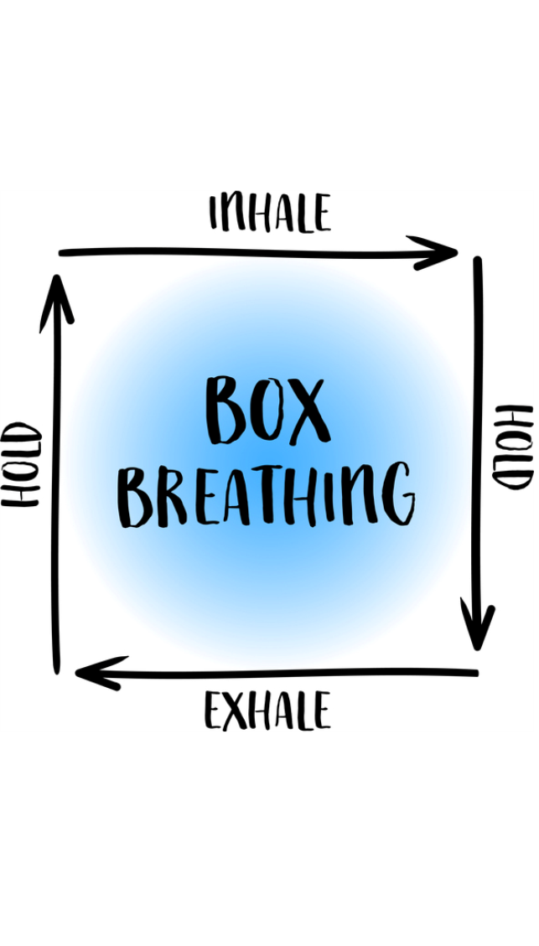
Tips to get started
Practice in a quiet place
Don’t pressure yourself
Stop if needed
Find which type works for you
Notes:
To Change a Picture
Right click on the picture you want to change, click “change picture,” then “from a file.”
O:\Wholesale Sales & Marketing\1. HealthCheck360\8. Templates\PowerPoint\Photos for PowerPoint

Slide 7

Summary
Breathwork can benefit many areas
Try different techniques based on preference and health conditions
Practice!
Notes:
To Change a Picture
Right click on the picture you want to change, click “change picture,” then “from a file.”
O:\Wholesale Sales & Marketing\1. HealthCheck360\8. Templates\PowerPoint\Photos for PowerPoint

Slide 8


Upcoming Webinars
What is Intuitive Eating?
Navigating Healthcare
Explore the power of intuitive eating and find out how this practice can improve your nutrition. Learn how to honor your hunger and finally make peace with food.
September 3
The world of health care can be confusing. Join our healthcare expert to get tips on navigating a carrier website to find the best care at the best price.
October 1

Slide 9

Lifestyle Rewards
True or False: Breathwork is only beneficial for stress management.
  True
  False
What was one type of breathwork mentioned?
  4-7-8
  Triangle
What was a tip for starting breathwork mentioned?
  If it doesn’t work the first time, don’t try it again
  Find a quiet place
* If your company has elected questions for lifestyle rewards, it will be noted when you submit on your account.
Notes:
To Change a Picture
Right click on the picture you want to change, click “change picture,” then “from a file.”
O:\Wholesale Sales & Marketing\1. HealthCheck360\8. Templates\PowerPoint\Photos for PowerPoint
To Change an Icon: Go to “Insert” in the top menu, click icons, then select the icon you wish to include. You can update the color under the “Shape Format” tab.

Slide 10

Get in Touch
Social Media
www.facebook.com/healthcheck360
www.healthcheck360.com/blog
www.instagram.com/healthcheck360/
@HealthCheck360 or #HealthCheck360
Watch past webinars and register for upcoming
www.healthcheck360.com/blog
Contact a Health Coach
1-866-511-0360 or healthcoach@healthcheck360.com
Notes:
To Change a Picture
Right click on the picture you want to change, click “change picture,” then “from a file.”

Slide 11

Questions?
Notes:
To Change a Picture
Right click on the picture you want to change, click “change picture,” then “from a file.”
O:\Wholesale Sales & Marketing\1. HealthCheck360\8. Templates\PowerPoint\Photos for PowerPoint

